Slide 1
How to get offline maps with an hybrid app ?
Meetup Cordova/PhoneGap Paris # 11
25/05/2015
Benjamin MICHEL

Slide 2



Hello!
Benjamin MICHEL
You can find me at:
@benjmichel

Slide 3

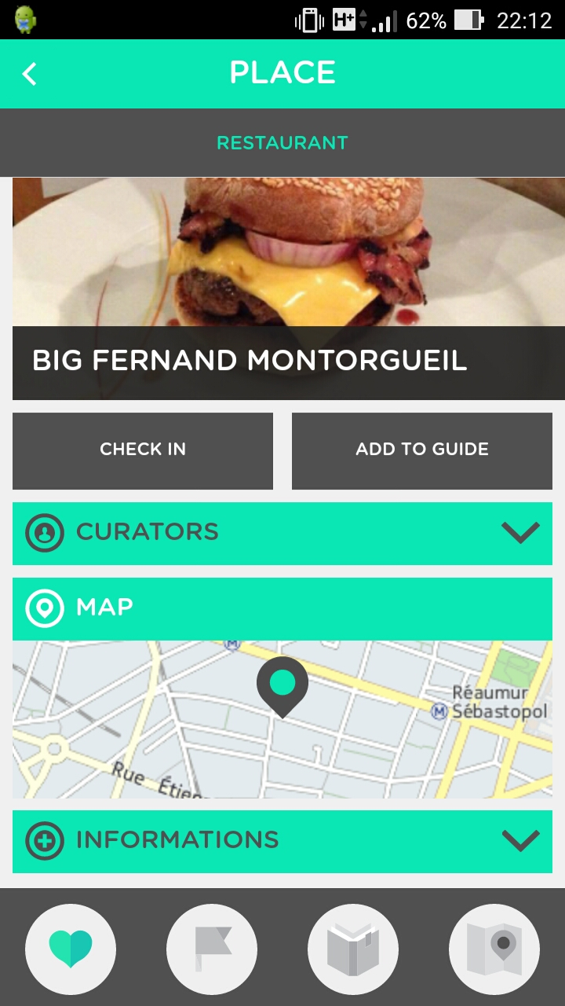
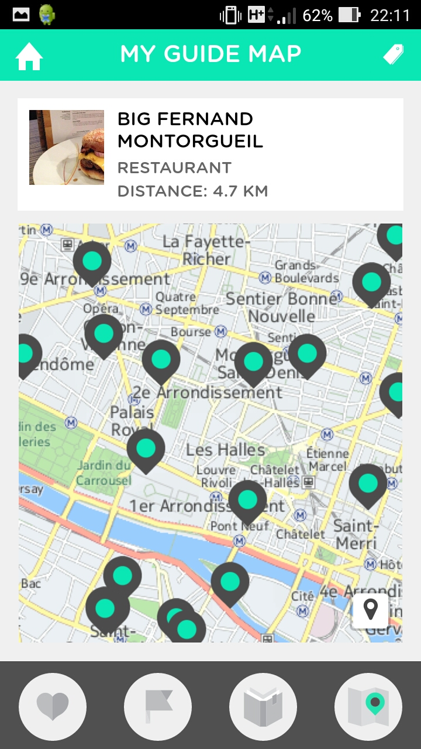
an online and offline travel guide

Slide 4



Technologies

Slide 5
1.
What is a map ?

Slide 6

A map is set of tiles

Slide 7
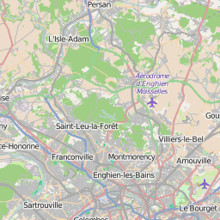
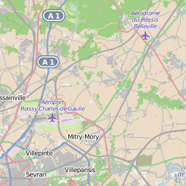
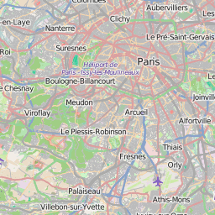
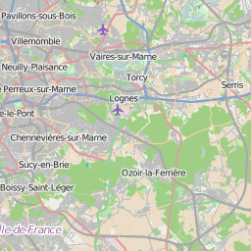
A map is a set of tiles
Notes:
https://www.mapbox.com/guides/how-web-maps-work/

Slide 8
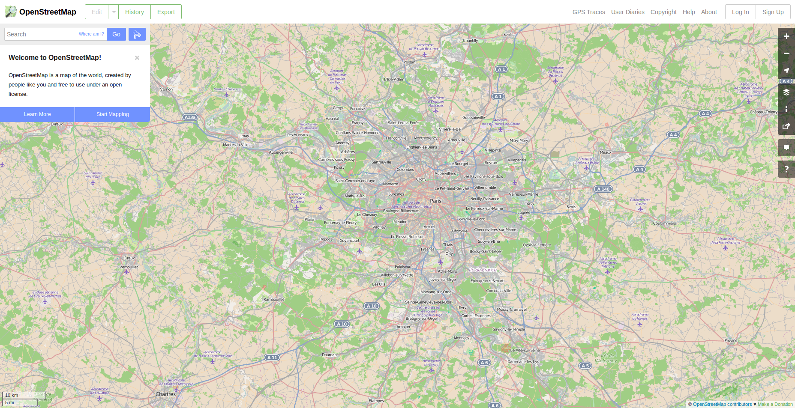
A map is a set of tiles
Notes:
https://www.mapbox.com/guides/how-web-maps-work/

Slide 9
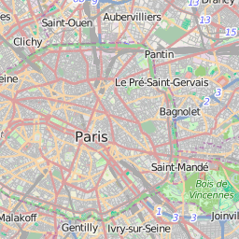
A map is a set of tiles
zoom: 10
zoom: 11
Zooming
Notes:
https://www.mapbox.com/guides/how-web-maps-work/

Slide 10
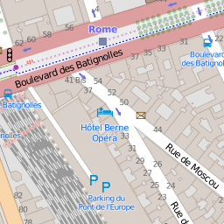
What is a tile ?
256 * 256 pixels
7 - 40 KB
For each tile:
a zoom level (between 0 and 19)
x and y coordinates

Slide 11
Tile provider
http://a.tile.openstreetmap.org/13/4149/2817.png
The tile provider
Your app

Slide 12
The strategy
In your backend, download all the tiles and create a package with them
In your app, import the package
1.
2.
Tile rendering server
Backend
(parse.com)
Mobile app

Slide 13
2.
Get all the tiles !

Slide 14
Choose your tile rendering server
Be careful on the terms of the service !
Google maps
Here.com
Open Street maps
Or set up your own server ! Ex: Mapnik

Slide 15
Choose the boundaries and the zoom level
Example: Paris and its close suburbs from zoom 11
Zoom level | Number of tiles | Total size
16 | 2000 | 50 MB
17 | 7500 | 200 MB

Slide 16
Packaging the tiles
Convert the boundaries from lat/lon to tiles numbers
Loop to download the tiles
Create a package with the tiles

Slide 17
The number of requests per minute exceeds the limit

Slide 18
3.
Importing the tiles in your app

Slide 19
Storage
Local storage
limit at 50 MB
SQLite
no easy way to serve files for leaflet since it uses an URL with params to fetch tiles:
http://a.tile.openstreetmap.org/{z}/{x}/{y}.png
File system

Slide 20
Leaflet.js
Set the URL in leaflet for the tiles:
$scope.defaults = tileLayer: cordova.file.dataDirectory+'tile_{z}_{x}_{y}.png'
Set the min and max zoom levels and the boundaries

Slide 21
The memory on iOS reached 500 MB when downloading a package -> crash

Slide 22
Write a native plugin
Write plugin.xml
Write the native code
Call the method with cordova.exec

Slide 23
During this presentation
What is a map ?
Download the tiles from a tile rendering server
Import the tiles in your application

Slide 24
Thanks!
Any questions?
You can find me at:
@benjmichel
http://blog.bamlab.fr/how-to-build-an-offline-map-system-for-an-hybrid-app/

Slide 25
CREDITS
Special thanks to all the people who made and released these awesome resources for free:
Presentation template by SlidesCarnival
Photographs by Death to the Stock Photo (license)

